Slide 1
Control Systems Project
Presented by: Muhammad Ali
Registration Number: 19pwcse1801
Section: a
Date: 10/01/2023
DCSE, uet Peshawar

Slide 2
Project steps
Firstly check the stability of the system steady state modal.
Using all the stability method I know.
Compute controllability and observability tests for the system.
If both test passes design a suitable controller.
Simulate the system using design controller.
Design PID controller and compare the response with designed suitable controller.
Compute the steady state errors.
Design tracking controller for the signals 5u(t) and 5t(t).

Slide 3
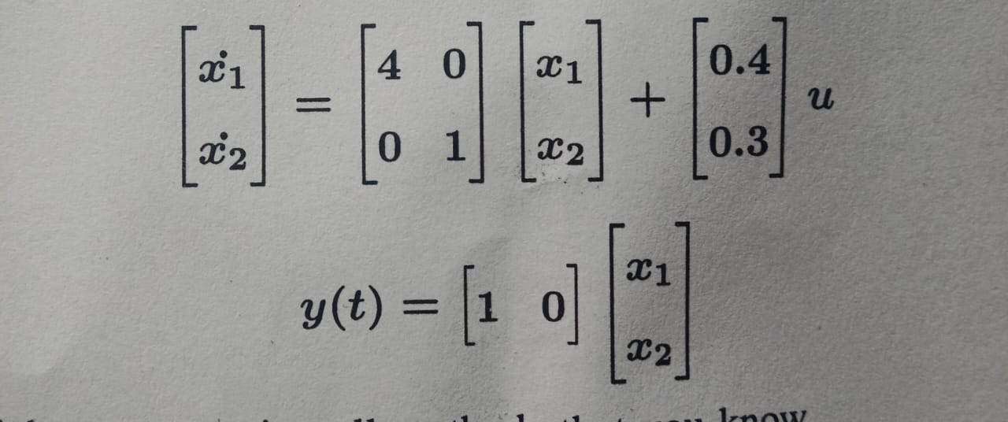
State-Space modal
State-space modal:

Slide 4
Checking Stability: 1st method
Finding eigenvalues of the system.
The system is unstable If all values is/are non-negative.
MATLAB code:
%stability check 1st method: eigenvalues, poles of the system
egen_values = eig(A);
disp('eigenvalues of matrix A are: ‘);egen_values
[nom den] = ss2tf(A,B,C,D); poles_tf = roots(den);
disp('Poles of tranfer fuction are: ‘);poles_tf

Slide 5
Commad line result: -
eigenvalues of matrix A are: egen_values =
1
4
poles of matrix A are: Poles_p =
4
1

Slide 6
Checking Stability: 2nd method
Finding poles and zeros map.
The system unstable if all poles are on the positive side.
MATLB code:
%poles zeros map
pzmap(A, B, C, D);
title('pole-zeros map of system')

Slide 7
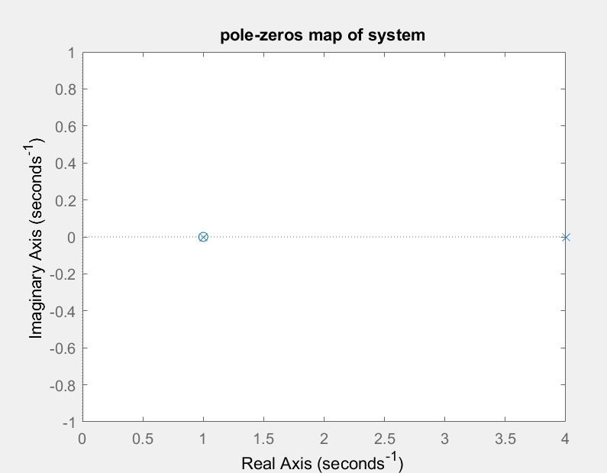
Poles-zeros Map
Cross denote poles and zero donate zeros of the system.

Slide 8
Checking Stability: 3rd method
Finding step response of the system.
The system unstable if the response is unbounded.
MATLAB code:
%stability check method 3rd: step response
figure;
step(A,B,C,D);
title('step response of the system ')
ylabel('Amplitude of step response')

Slide 9
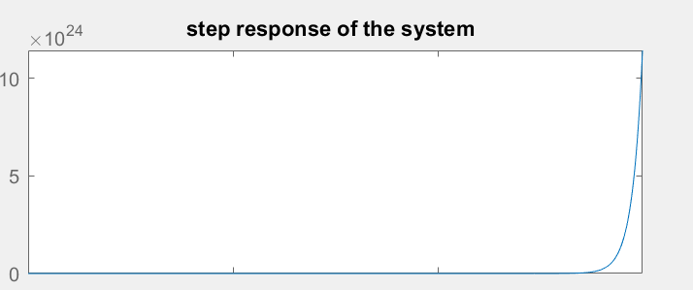
Step response
Unbounded response of the system.

Slide 10
Designing suitable controller observer based state feedback controller
There are some prerequisites to design a controller.
Matrix C must not be equal to identity and matrix D must be zero or absent.
The system must pass controllability test.
The system must pass observability test.
Note: according to the given state space modal 1st prerequisite is satisfied, I will design the suitable controller(observer based state feedback) if others two prerequisites are satisfied.

Slide 11
Prerequisite 2:Controllability test
A system is controllable if the following criteria satisfied.
Find determinate of the system and denote as n.
Construct P matrix follows:
P = [B AB]
Compute rank of P and check if rank is equal to n or not.
Note: The system is controllable and can proceed to design of controller if rank(P)=n, otherwise No controller can not be design.

Slide 12
Prerequisite 2:Controllability test
MATLAB CODE:
%controllability test
%P = [B A*B] determinate = det(P)
P = ctrb(A,B);
Rank_ctrb = rank(P);
disp('Rank of controllability matrix is')
Rank_ctrb

Slide 13
Prerequisite 2:Controllability test
MATLAB result:
Rank of controllability matrix is
Rank_ctrb = 2
order of the system
Order = 2
Rank(P) = n, So the system passes Controllability test

Slide 14
Prerequisite 3:Observability test
A system is observable if the following criteria satisfied.
Find determinate of the system and denote as n.
Construct Q matrix follows:
Q = [C; CA]
Compute rank of Q and check if rank is equal to n or not.
Note: The system is observable and can proceed to design of controller if rank(P)=n, otherwise No controller can not be design.

Slide 15
Prerequisite 3:Observability test
MATLAB code:
%observability test
Q = [C; C*A];
q = obsv(A,C);
Rank_Q = rank(q);
disp('the rank of matrix Q is')
Rank_Q

Slide 16
Prerequisite 3:Observability test
MATLAB result:
the rank of matrix Q is
Rank_Q = 1
order of the system
Order = 2
Rank(Q) != n, So the system not observable.

Slide 17
Conclusion
The system fulfill first prerequisite.
The system is controllable or it passes controllability test.
The system is NOT observable or didn’t passes observability test.
So STOP No controller can be design.
And the system is unstable So no steady state error can be computed.

